Slide 1

ROBOT MANAGER - O V E R V I E W
RM purpose and responsibilities
Feature Flow - Goto Example
Nodes Interactions
Node Structure

Slide 2

ROBOT MANAGER - PURPOSE
Main Goals:
Robot manager is incharge on the execution of external (user) and internal (system) commands.
Translate commands to excutional flow
Trigger the required nodes into action and operate accordingly
Decision making
Filter invalid inputs and alert/take action accordingly
Process the data and carry out the desired command according to plan
On-Going system status reports.
Robox node status report
Feature status report
“Behind the scenes” commutinction with the other nodes
continuous data and other inputs exchange (locations, traversability, status , obstacles, etc..)

Slide 3
ROBOT MANAGER - NODES INTERACTIONS
MOTHERBOARD
COMMAND PARSER
PATH PLAN
DEPTH TRACK
Publish:
Desired Velocity (V, W), keep alive
PID configurations
Lidar RPM
Microphone desired angle
Subscribe:
Odometry
IMU
AdvanceStatus
Publish:
Statuses (nodes, sensors, obstacles, states and more)
Locations
Subscribe:
User Commands
Internal Commands
Publish:
Path Plan Requests (by type)
Subscribe:
Planned Path
Publish:
Bewith
snap to user
person detection
desired tilt angle
Subscribe:
person detection
target location
LOCAL MAP
HEALTH MONITOR
SLAM
DYNAMIC TRACKING
Publish:
object to map (currently deprecated)
Subscribe:
Velocity Check
collision on trajectory
velocity approval and mofidication
Obstacle Status and details
Publish:
Features Status
keep alive
Subscribe:
Nodes Status
System events
Publish:
Traversability (visited poses)
Map services: reset, load, save
locations handling
future: stack, obstacles, persons, etc.
landmarks - (currently deprecated)
Subscribe:
Map services status: (succeeded, failed)
live locations
Publish:
Bewith - start / stop
Subscribe:
Dynamic object (currently only for bewith)

Slide 4

ROBOT MANAGER - NODES INTERACTIONS
TILT
DOCKING
Publish:
Subscribe:
Tilt angle
Publish:
Docking detection command - start / stop
Subscribe:
Home Base position and orientation

Slide 5
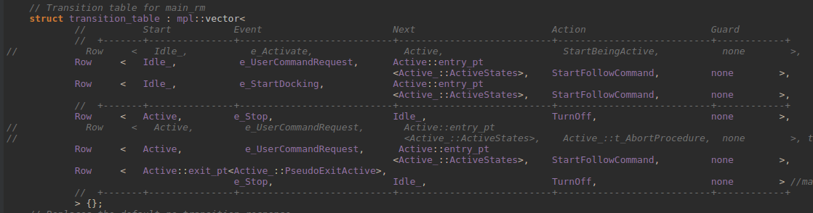
ROBOT MANAGER - Node Structure
Benefits:
Organized and intolerable to undefined transitions between states/substates
runtime
Adjustable
Disadvantages
“boost” library limitations
slow compile time
Main High Level MSM (Meta State Machine) Design
Inherited from “boost” MSM library
Implemented in hierarchically form (MSM’s pattern):
main state / substate
events
external / internal transition and proper guard
entry / exit action
Safe entry, exit, transition procedures

Slide 6
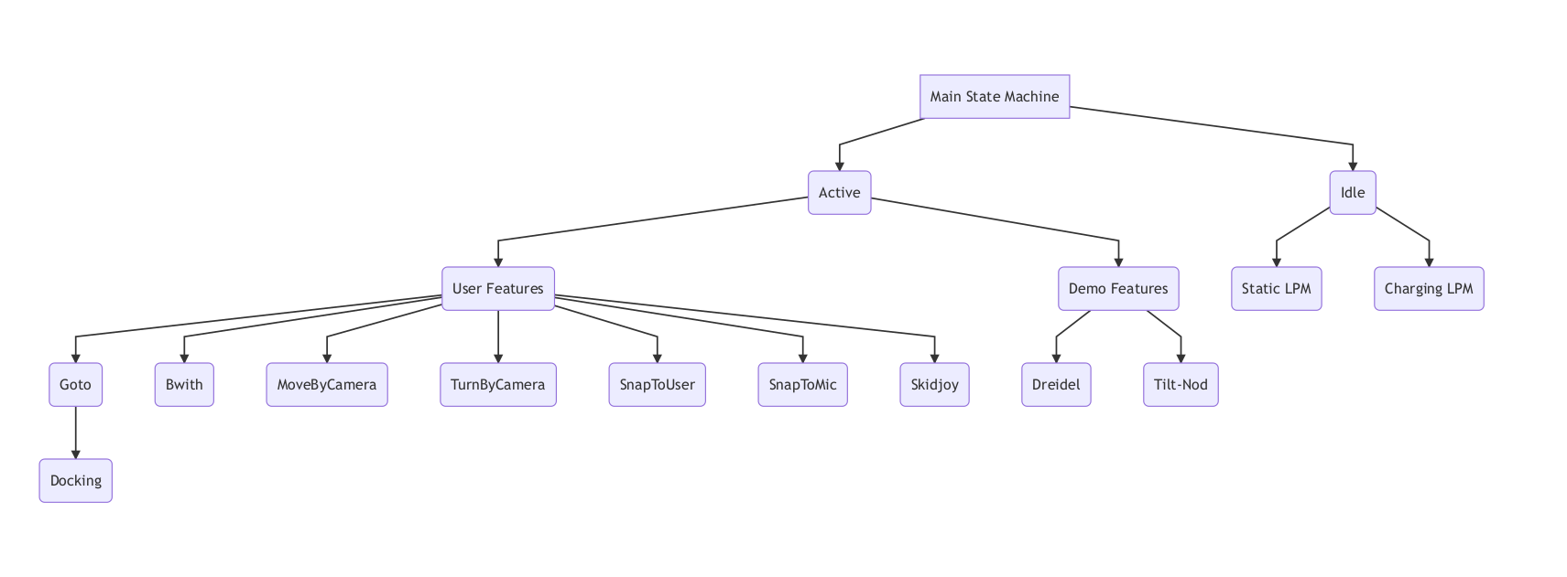
ROBOT MANAGER - MAIN STATE MACHINE

Slide 7

ROBOT MANAGER - Node Structure
Managers Division
Inherited manager for every responsibility
manager for every node interaction
manager for each assignment
velocity
locations
robox status
msgs status
traversability
etc…
Benefits:
Easier control on each responsibility
Scalable
Saves reused logics and code
Feature Manager
goto
bewith
moveby
snaptouser
etc.
each feature has its own unique quality
common attributes and structure
movements types (currently not implemented)

Slide 8
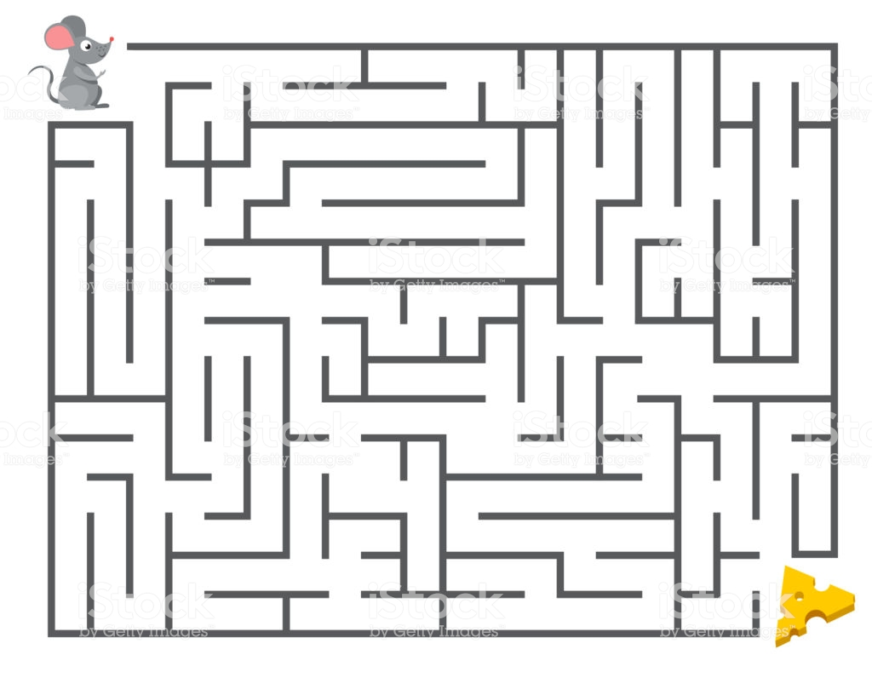

ROBOT MANAGER - Feature Flow Example (Goto)

Slide 9
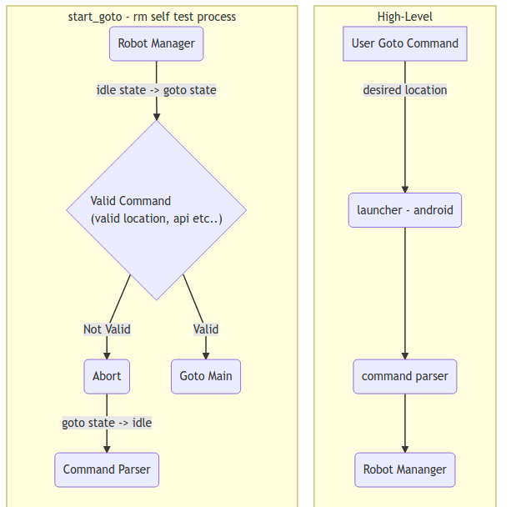
ROBOT MANAGER - Feature Flow Example (Goto)

Slide 10
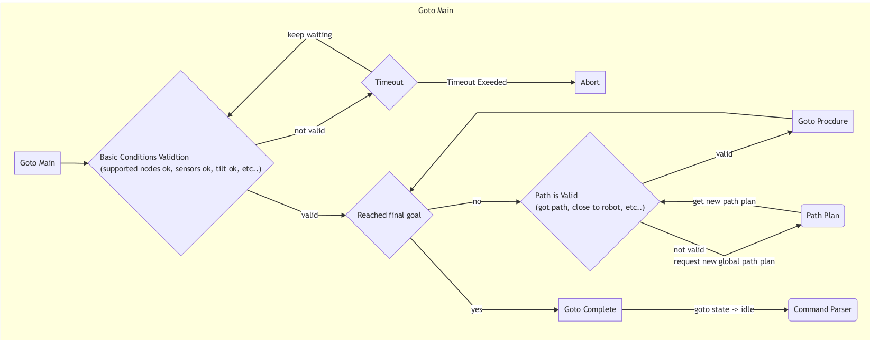
ROBOT MANAGER - Feature Flow Example (Goto)

Slide 11
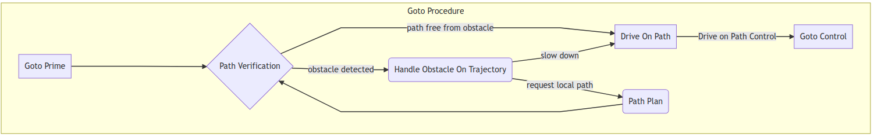
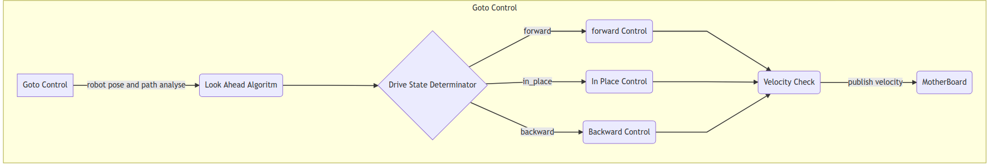
ROBOT MANAGER - Feature Flow Example (Goto)

Slide 12
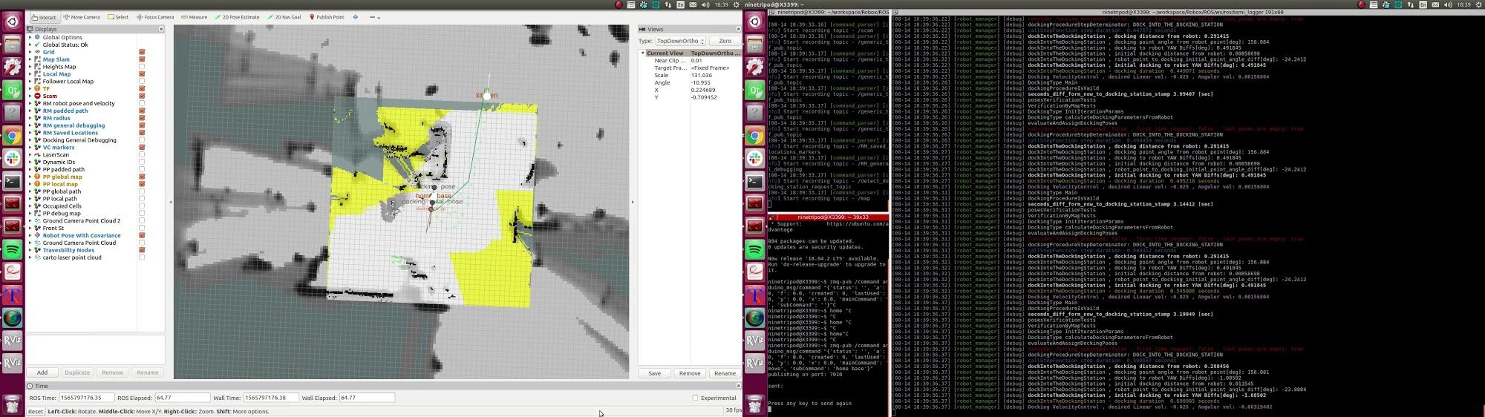
ROBOT MANAGER - Feature Flow Example (Goto)

Slide 13

QUESTIONS

